Slide 1
Computer Architecture W3D1: A Real Intro Computer Architecture
Jian Weng
Computer Science
CEMSE, KAUST

Slide 2
Roadmap
What is an architecture?
What are the laws?
How to measure the performance?
How to improve the performance?
Why should we have better performance?

Slide 3
What is architecture?
ISA: Instruction Set Architecture
Something executes a set of instructions
The organization of the components to execute
A design of the underlying “something”

Slide 4




Globalization & End2end
Chip design
Chip tape-out

Slide 5
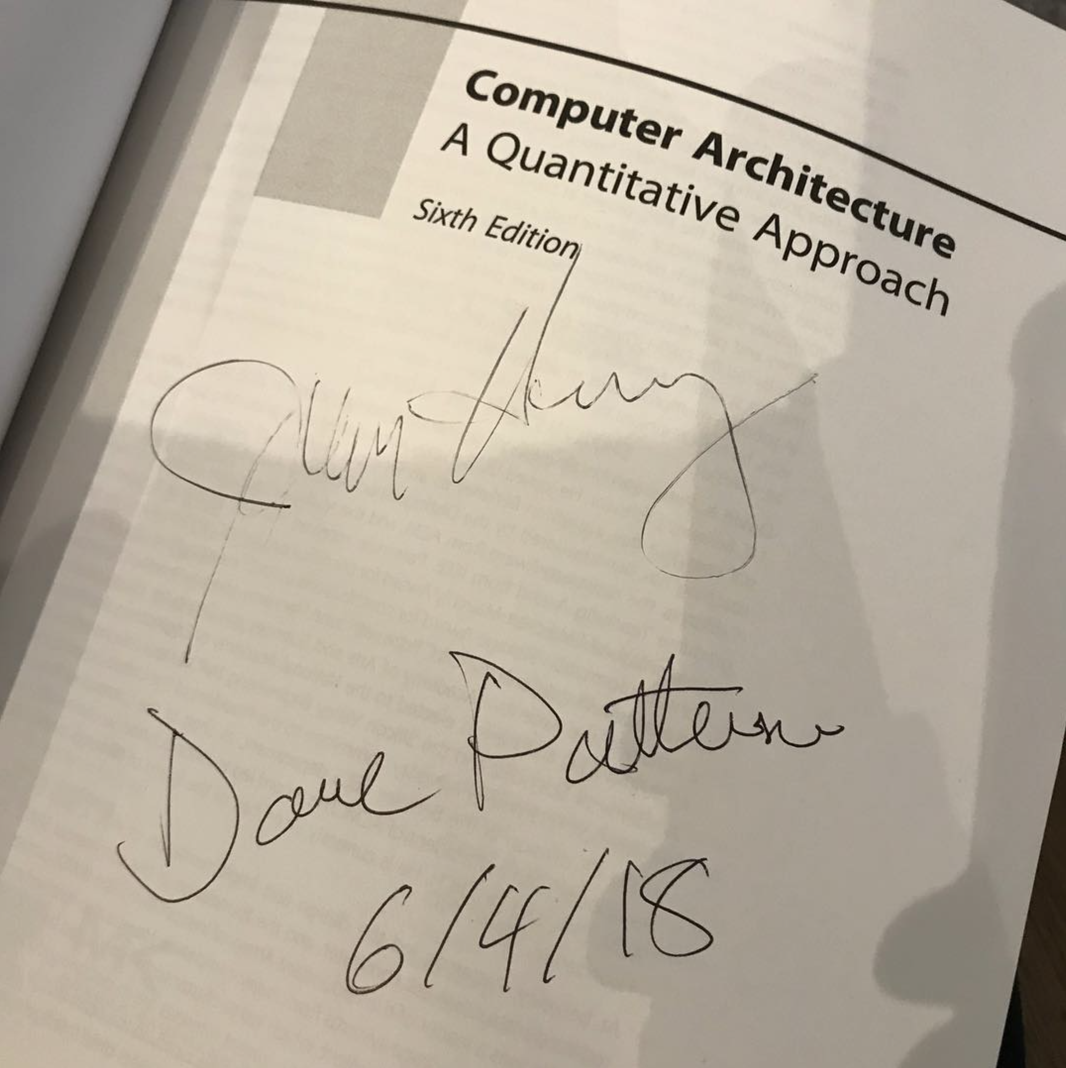
What is a Quantitative Approach?
(Nearly) Everyone learned (or will learn) computer architecture from this book
But what is the specific quantitative approach?
Macro: Where to have the performance?
Micro: How do we achieve this?

Slide 6
Quantitative Approach 1 – The Program Exec. Time
Where does time go?
Execution Time = Amount-of-work / Computing Power
Execution Time = #Instructions × (Time per Instruction)
But, it sounds like a correct non-sense!
t=s/v
s=tv
What insight does it reveal?
RISC v.s. CISC

Slide 7
Quantitative Approach 1 – The Program Exec. Time
Execution Time = #Instructions × (Time per Instruction)
Distance = Time × Velocity
#instructions
Faithfully execute the program, just like PoW
Reduce the number of instructions?
Time per Instruction
How to decrease the amortized time per instruction?

Slide 8
The Debate of RISC and CISC
RISC: RISCV, ARM, MIPS
Many general registers: RISCV has nearly 20
3-address opcode: $rd, $rs1, $rs2
Instruction operands in registers
Simple operations
CISC: X86
Few general registers: X86 just has 8
2-address opcode: something like $rd += $rs
Instruction operands IMR (imm, mem, reg)
Complex operations (?)
# RISCV-like
ld $t3, a($t1)
ld $t4, b($t1)
add $t5, $t4, $t3
sw $t5, a($t1)
# x86-like
add a(%eax), b(%eax)

Slide 9
Microcode: A bridge from CISC to RISC
Frontend: CISC instructions
One day, Intel finds its CISC ISA is too complicated to be decoded by dedicated circuits
Backend: Each complicated instruction would be broken down to simple RISC-like ones
This is also widely used in performance modeling [1]
# RISCV-like
ld $t3, a($t1)
ld $t4, b($t2)
add $t5, $t2, $t3
sw $t5, a($t1)
# x86-like
add a(%eax), b(%eax)
[1]: The gem5 simulator, https://www.gem5.org/

Slide 10
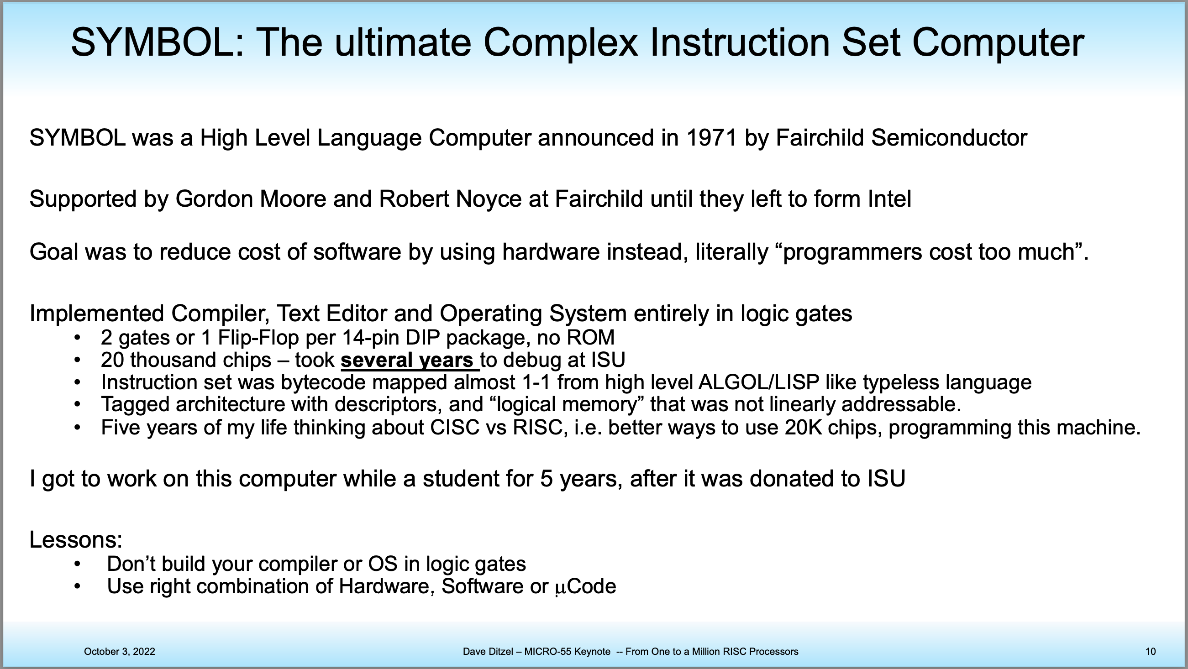

Slide 11
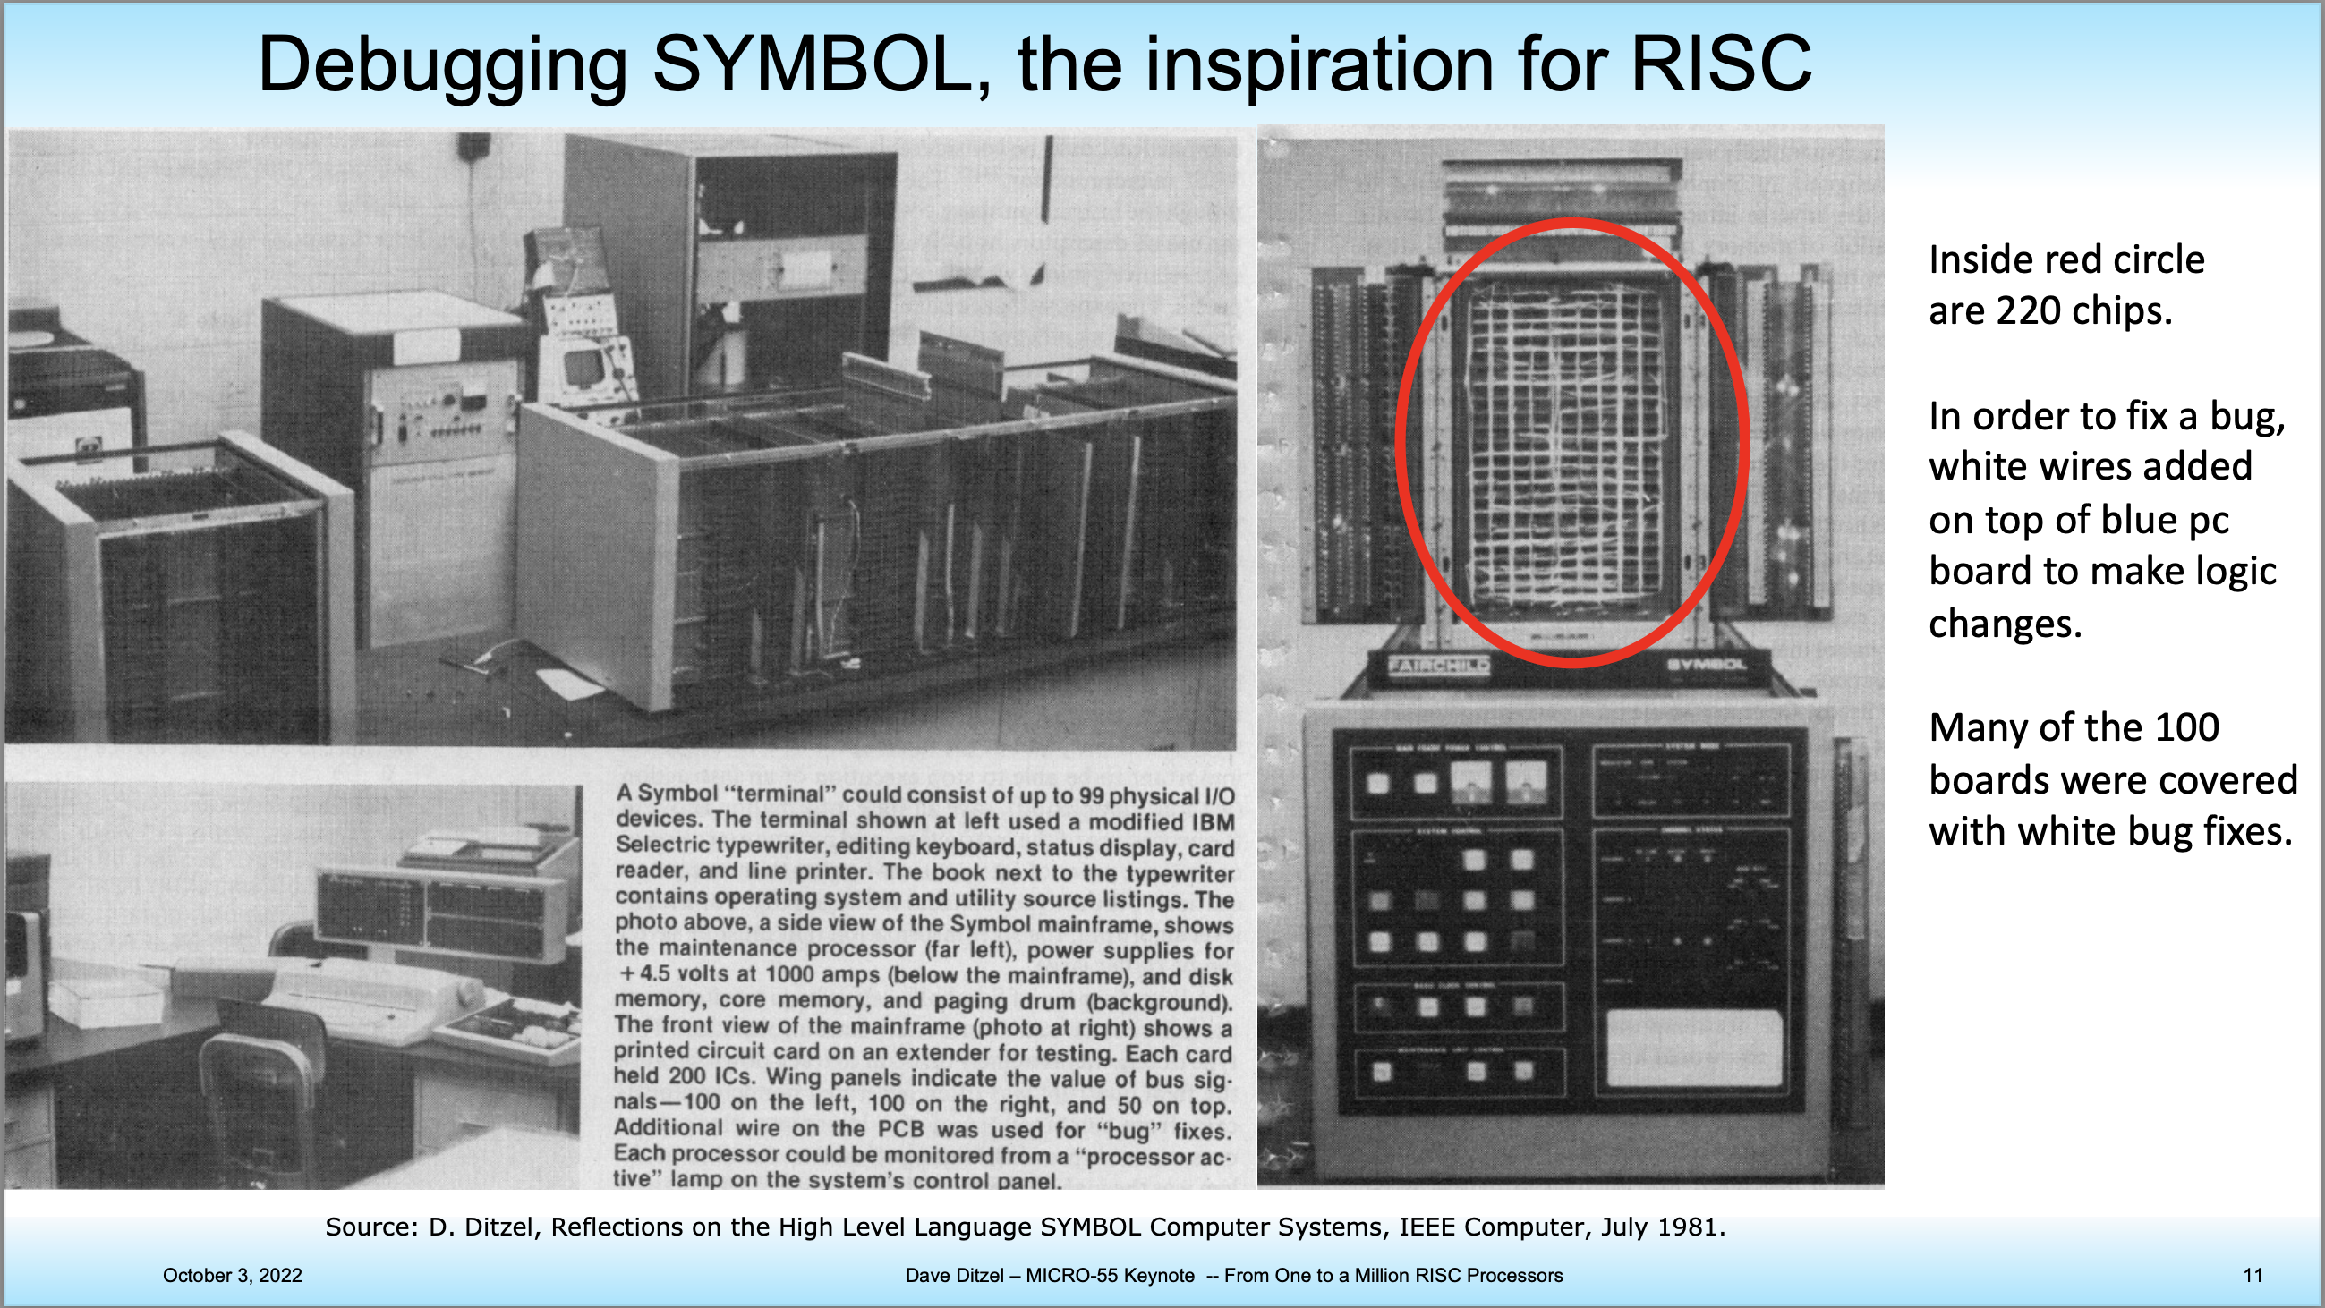

Slide 12
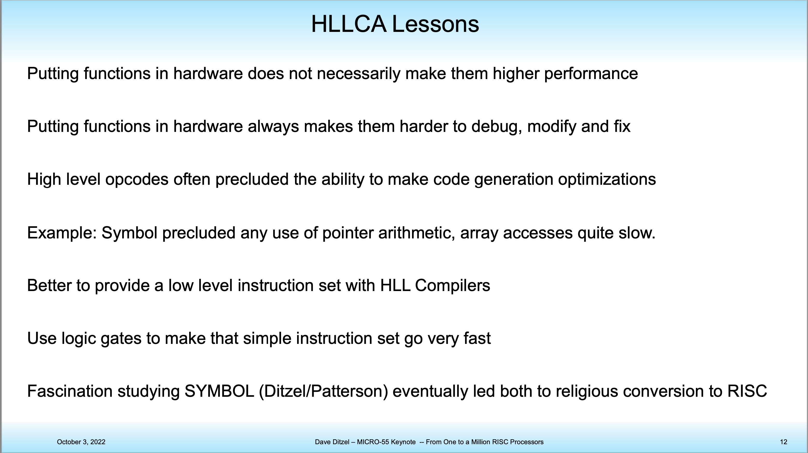

Slide 13
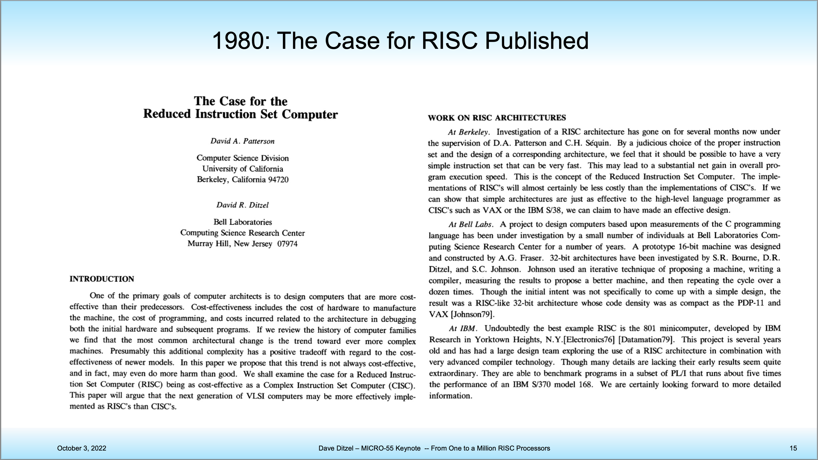

Slide 14
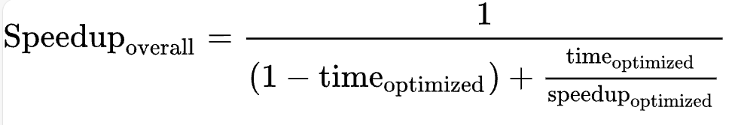
Quantitative Approach 2 – Amdahl’s Law
The speedup of a system you can earn from optimizing a portion of this system is dominated by the original % of this portion
👉🏻 Optimize the most critical portion first!

Slide 15
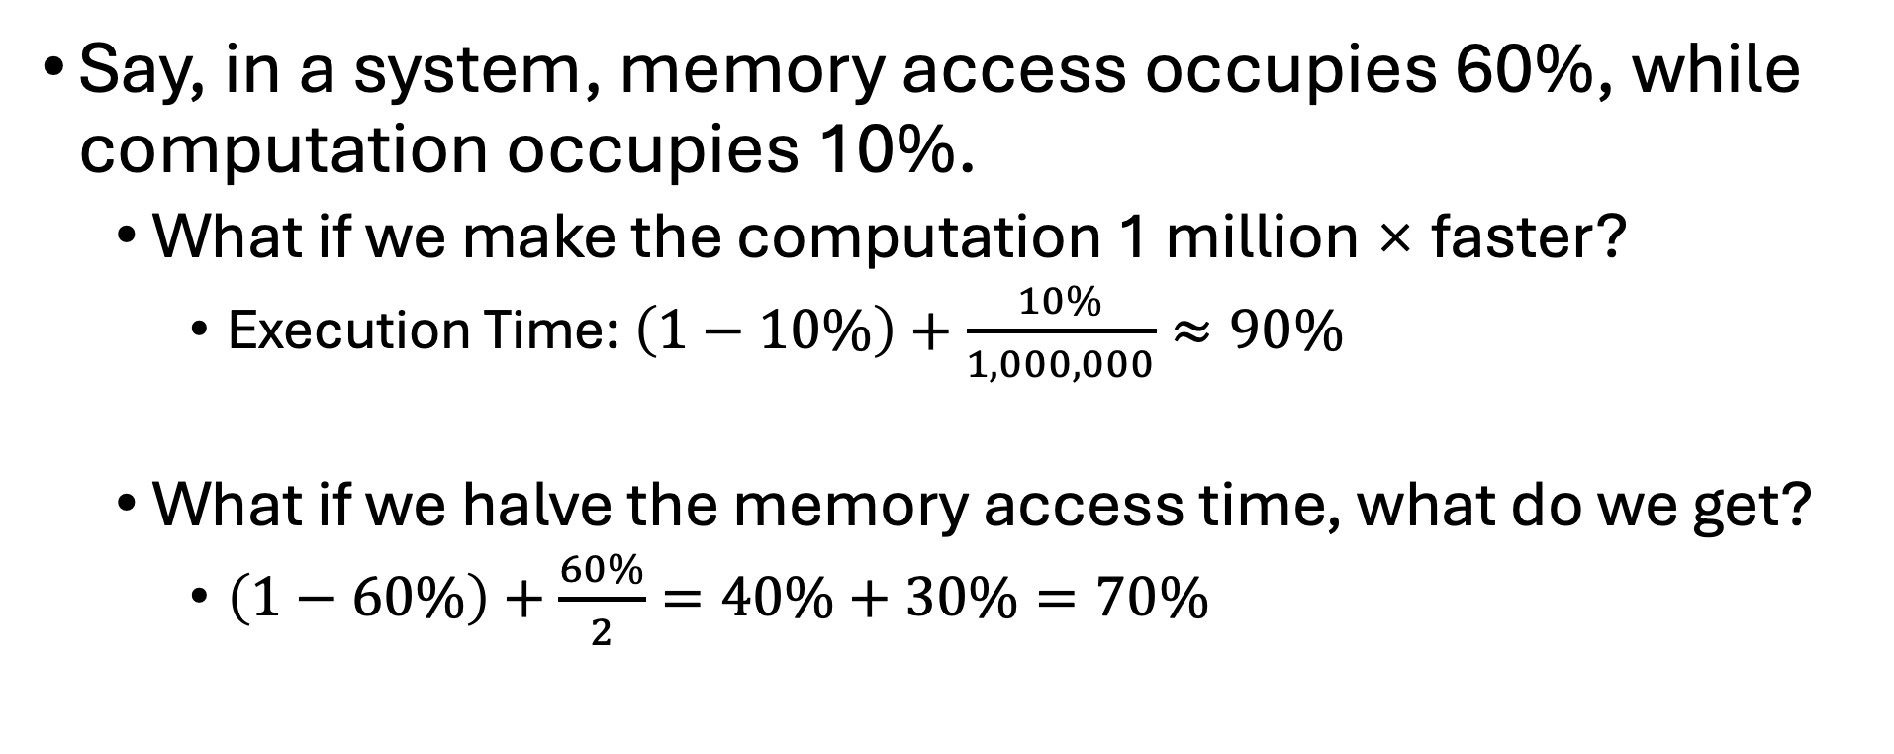
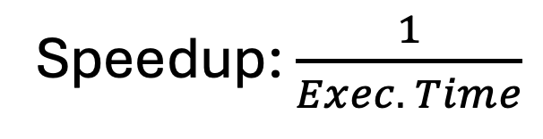
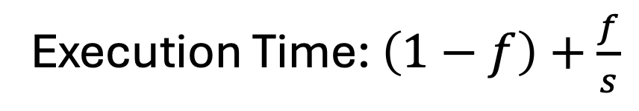
Amdahl’s Law (CONT’D)
Execution Time: $\left(1−f\right)+\frac{f}{s}$
Speedup: $\frac{1}{Exec. Time}$
Say, in a system, memory access occupies 60%, while computation occupies 10%.
What if we make the computation 1 million × faster?
Execution Time: $\left(1−10\%\right)+\frac{10\%}{1,000,000}≈90\%$
What if we halve the memory access time, what do we get?
$\left(1−60\%\right)+\frac{60\%}{2}=40\%+30\%=70\%$
The original execution time w/ optimized part excluded
Optimized execution time

Slide 16
Amdahl’s Law (CONT’D)
Execution Time: $\left(1−f\right)+\frac{f}{s}$
Speedup: $\frac{1}{Exec. Time}$
Say, in a system, memory access occupies 60%, while computation occupies 10%.
What if we make the computation 1 million × faster?
Execution Time: $\left(1−10\%\right)+\frac{10\%}{1,000,000}≈90\%$
What if we halve the memory access time, what do we get?
$\left(1−60\%\right)+\frac{60\%}{2}=40\%+30\%=70\%$
The original execution time w/ optimized part excluded
Optimized execution time

Slide 17
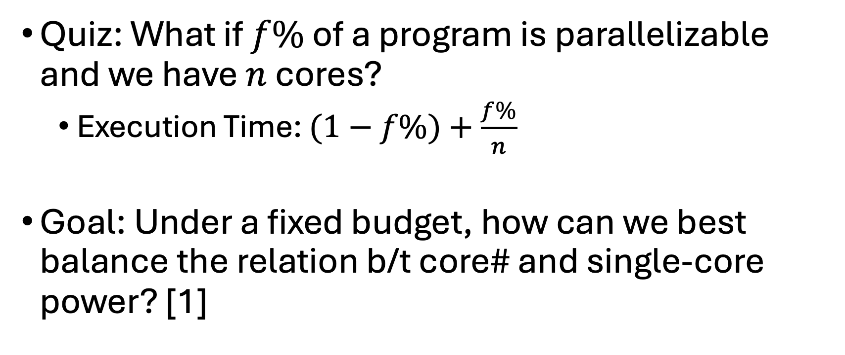
Amdahl’s Law in the Multi-core Era [1]
Quiz: What if $f\%$ of a program is parallelizable and we have $n$ cores?
Execution Time: $(1−f\%)+\frac{f\%}{n}$
Goal: Under a fixed budget, how can we best balance the relation b/t core# and single-core power? [1]
Sequential Part
Parallelized
[1] M. D. Hill and M. R. Marty, "Amdahl's Law in the Multicore Era," in Computer, vol. 41, no. 7, pp. 33-38, July 2008, doi: 10.1109/MC.2008.209.

Slide 18
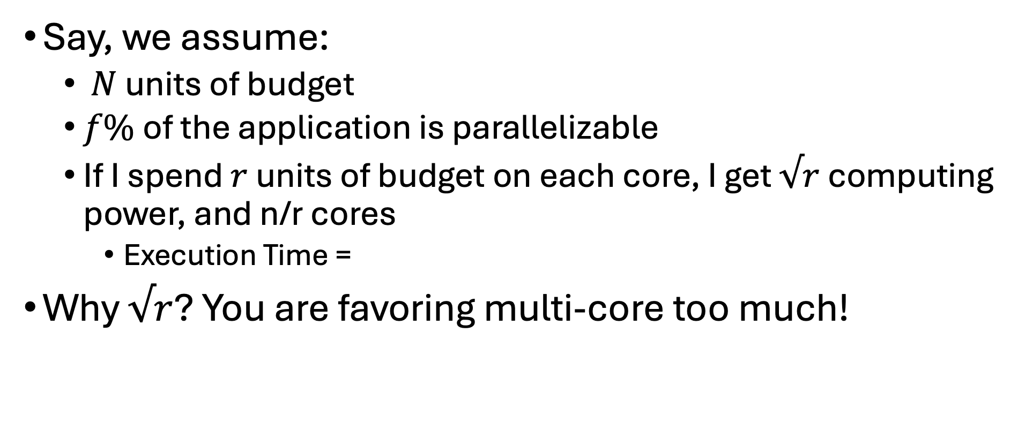
Amdahl’s Law in the Multicore Era (CONT’D)
Say, we assume:
$N$ units of budget
$f\%$of the application is parallelizable
If I spend $r$ units of budget on each core, I get $√r$ computing power, and n/r cores
Execution Time =
Why $√r$? You are favoring multi-core too much!
Amount of work
Computing power

Slide 19
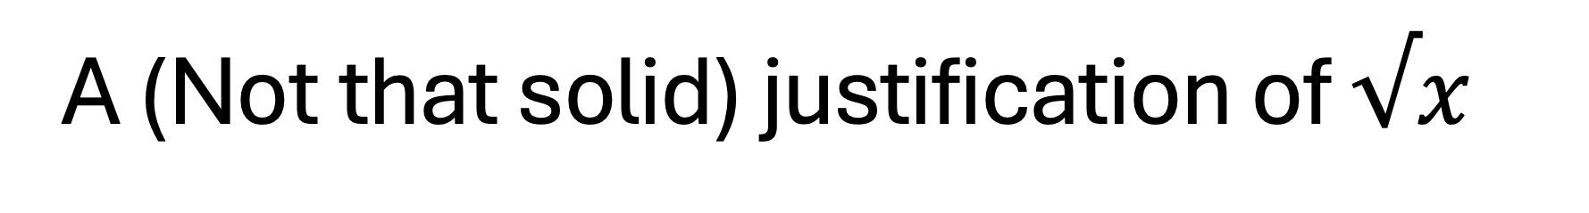
A (Not that solid) justification of $√x$
Did you played overclocking before?
Speedup the clock frequency to speedup your machine
Or tune down the frequency for better energy savings (ETH PoW Mining)

Slide 20
Recap: The Valve-Liquid Model
High
High
NAND: NOT (A & B)
NAND itself is Turing Complete
A & B
A | B
A ^ B
out
A
B
Low

Slide 21
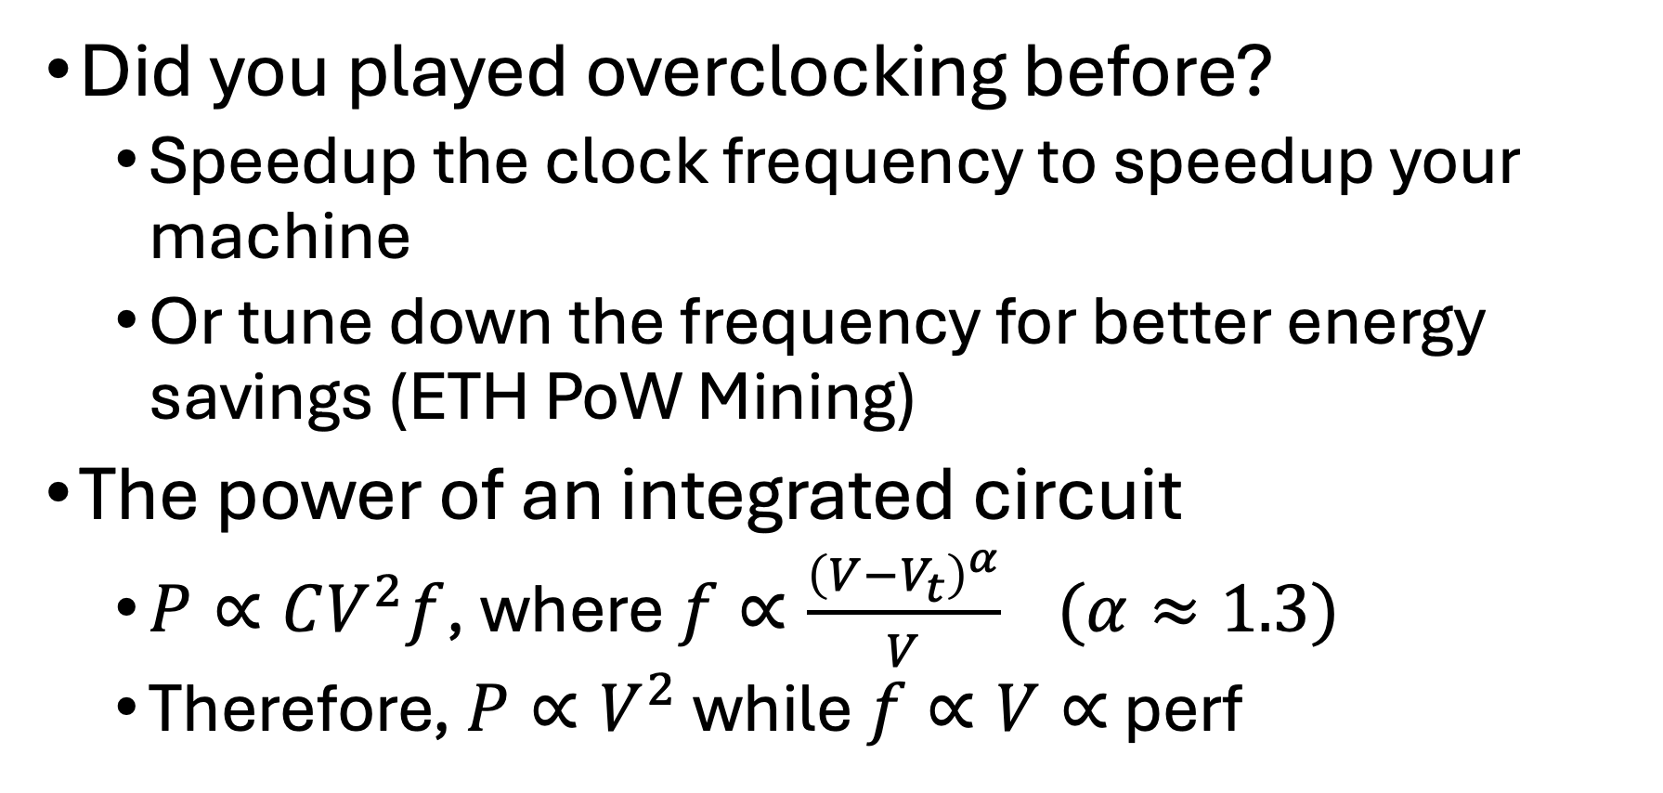
A (Not that solid) justification of $√x$
Did you played overclocking before?
Speedup the clock frequency to speedup your machine
Or tune down the frequency for better energy savings (ETH PoW Mining)
The power of an integrated circuit
$P∝CV^{2}f$, where $f∝\frac{{\left(V−V_{t}\right)}^{α}}{V} (α≈1.3)$
Therefore, $P∝V^{2}$ while $f∝V∝$ perf

Slide 22
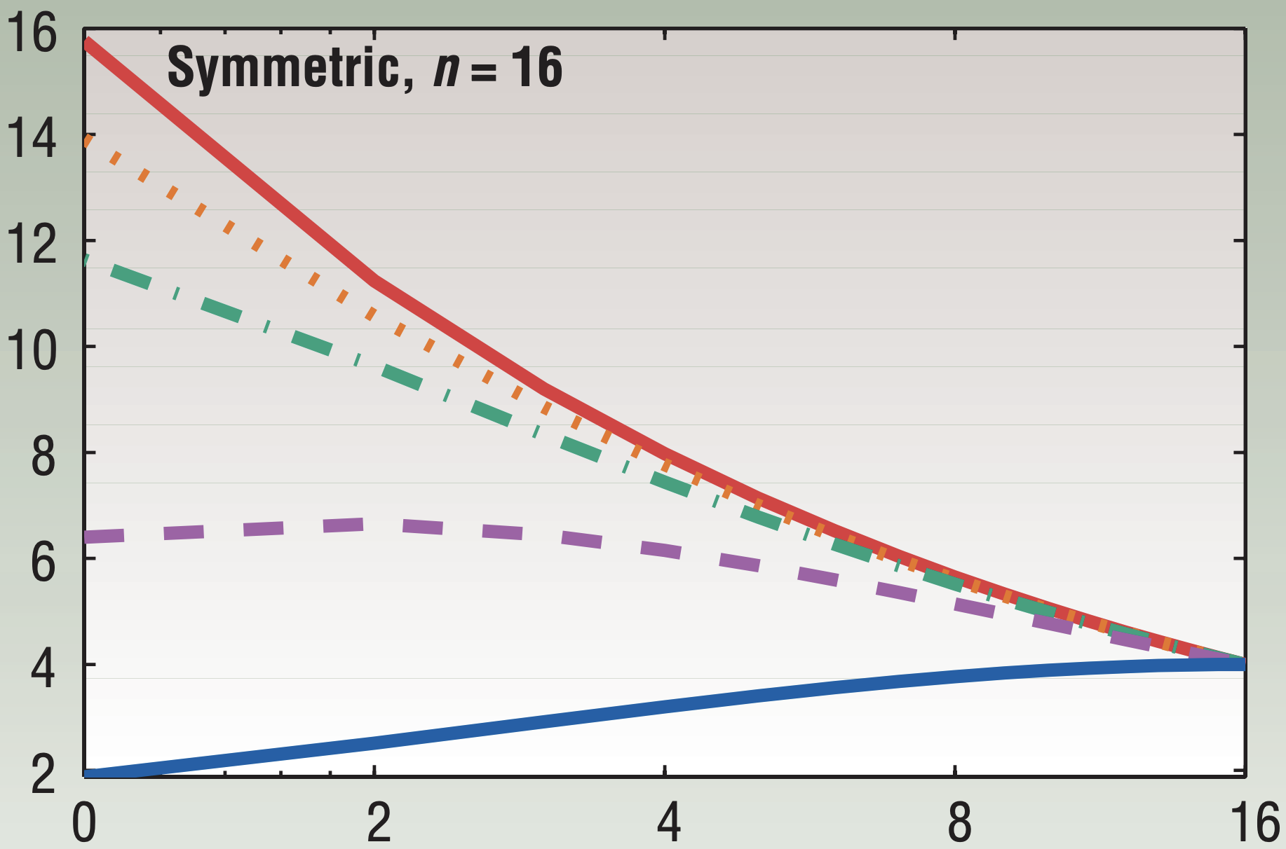
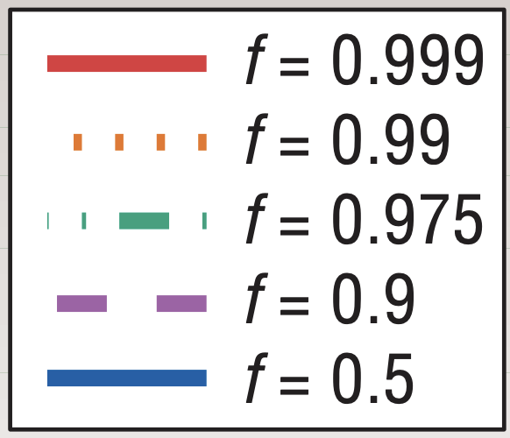
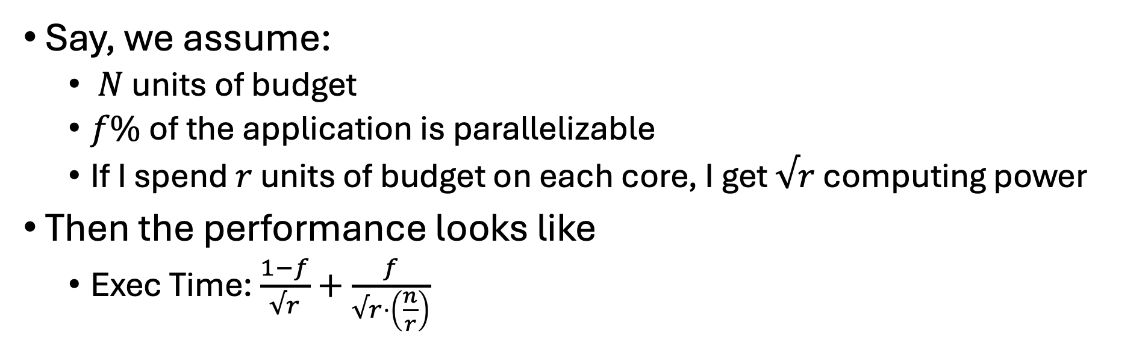
Amdahl’s Law in the Multicore Era
Say, we assume:
$N$ units of budget
$f\%$of the application is parallelizable
If I spend $r$ units of budget on each core, I get $√r$ computing power
Then the performance looks like
Exec Time: $\frac{1−f}{√r}+\frac{f}{√r⋅\left(\frac{n}{r}\right)}$
Sequential exec time
Parallelizable sequential exec time
Divided by number of cores
Speedup over a core w/ 1-unit of budget

Slide 23
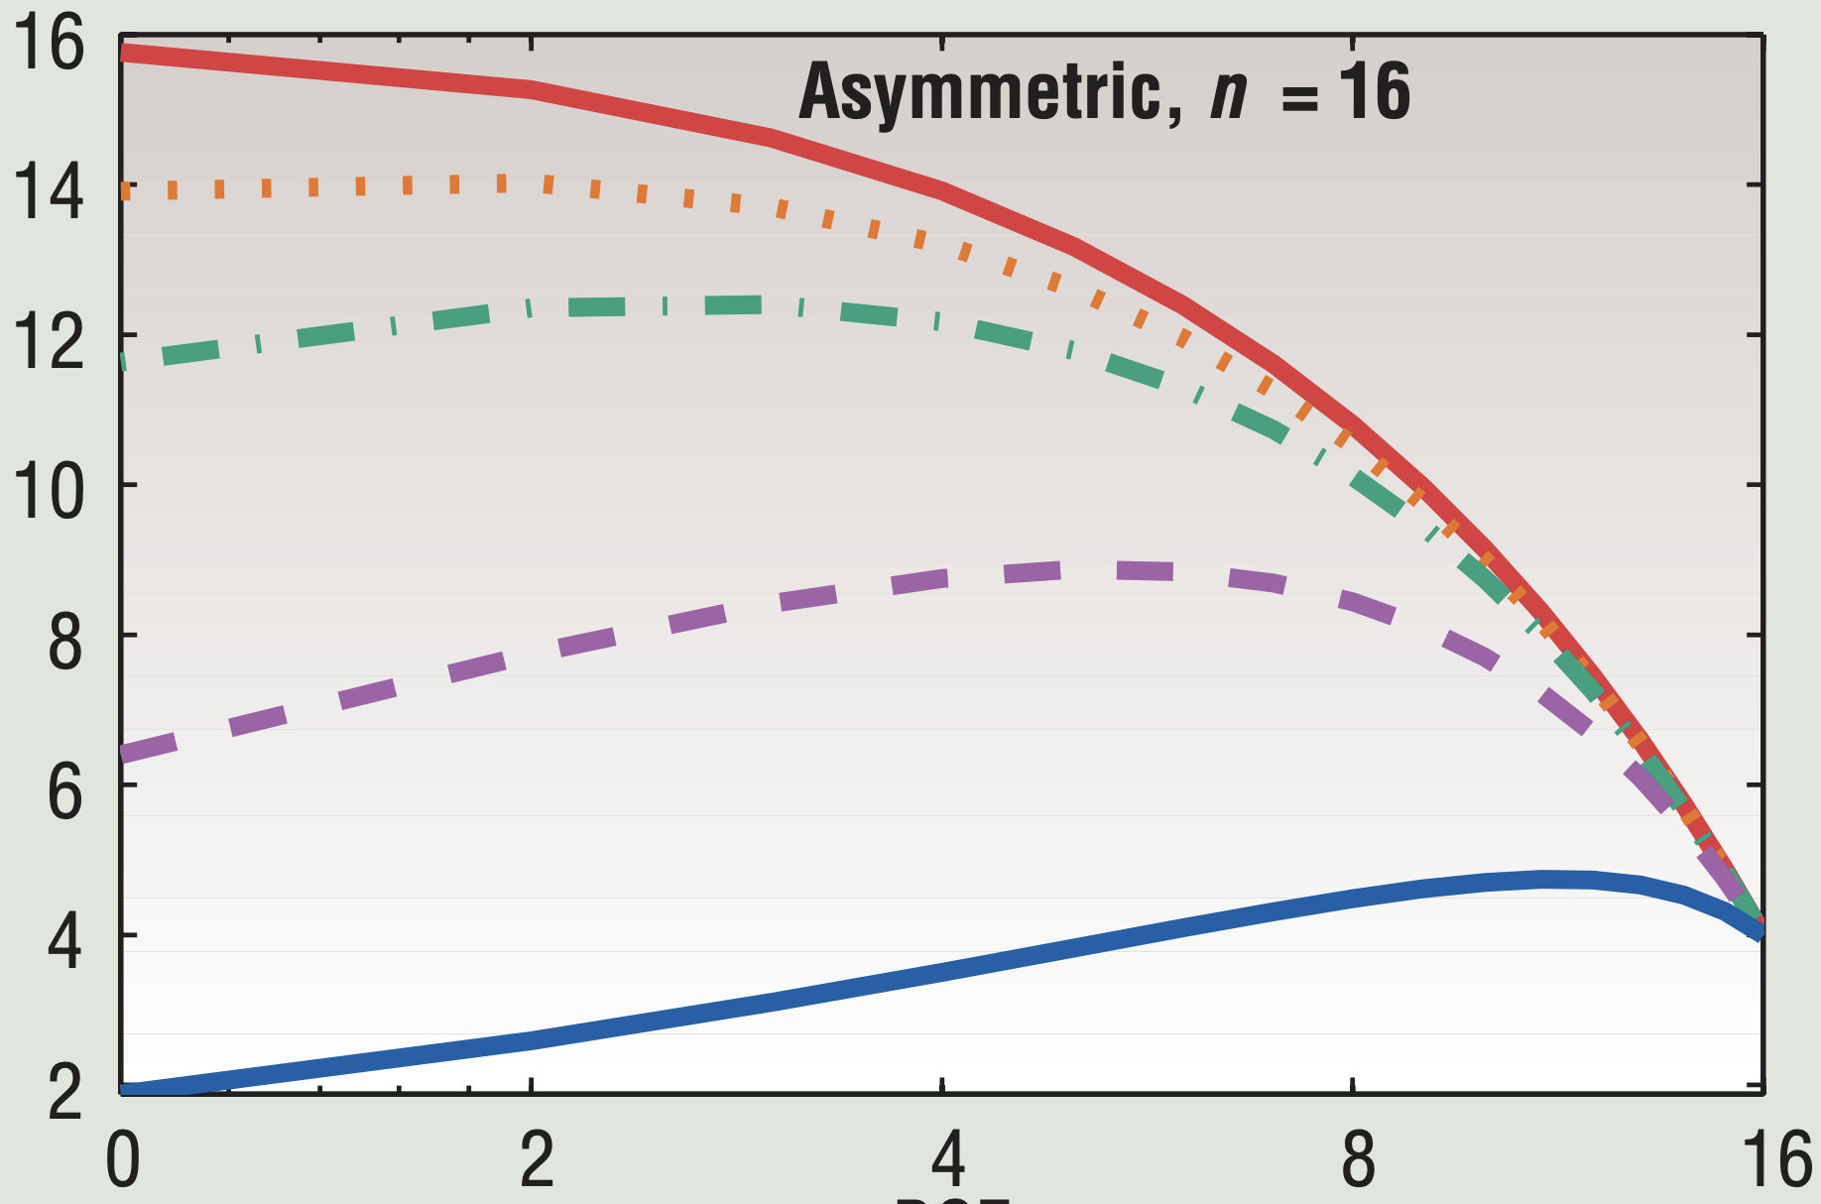
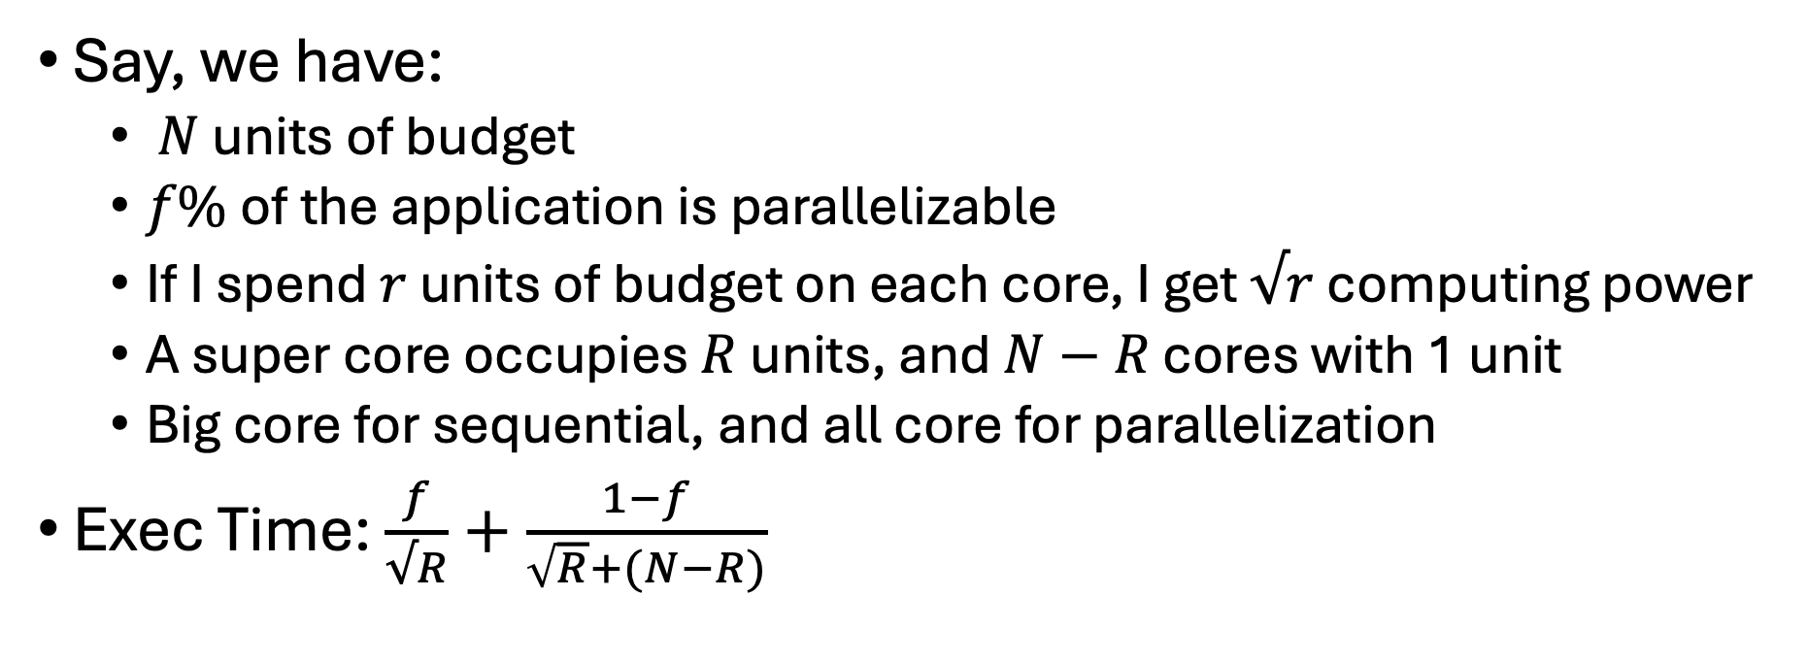
Amdahl’s Law in Heterogeneous Multicore Era (CONT’D)
Say, we have:
$N$ units of budget
$f\%$of the application is parallelizable
If I spend $r$ units of budget on each core, I get $√r$ computing power
A super core occupies $R$ units, and $N−R$ cores with 1 unit
Big core for sequential, and all core for parallelization
Exec Time: $\frac{f}{√R}+\frac{1−f}{\sqrt{R}+(N−R)}$
Sequential exec time
Big-core computing power
Small-core computing power
Speedup over a core w/ 1-unit of budget

Slide 24
Put them together!
Heterogeneous curves are higher then homogeneous one!
It is good to hybridize big/small cores when fixing the power budget.
Wait? Is it useful?

Slide 25
Amdahl’s Law in Heterogeneous Multicore Era (CONT’D)
This is widely adopted in:
your cell phones (Apple since A7 in 2010s)
and laptops (Intel AlfredLake in 2020s)
Relations among the Academia, and the Industries

Slide 26
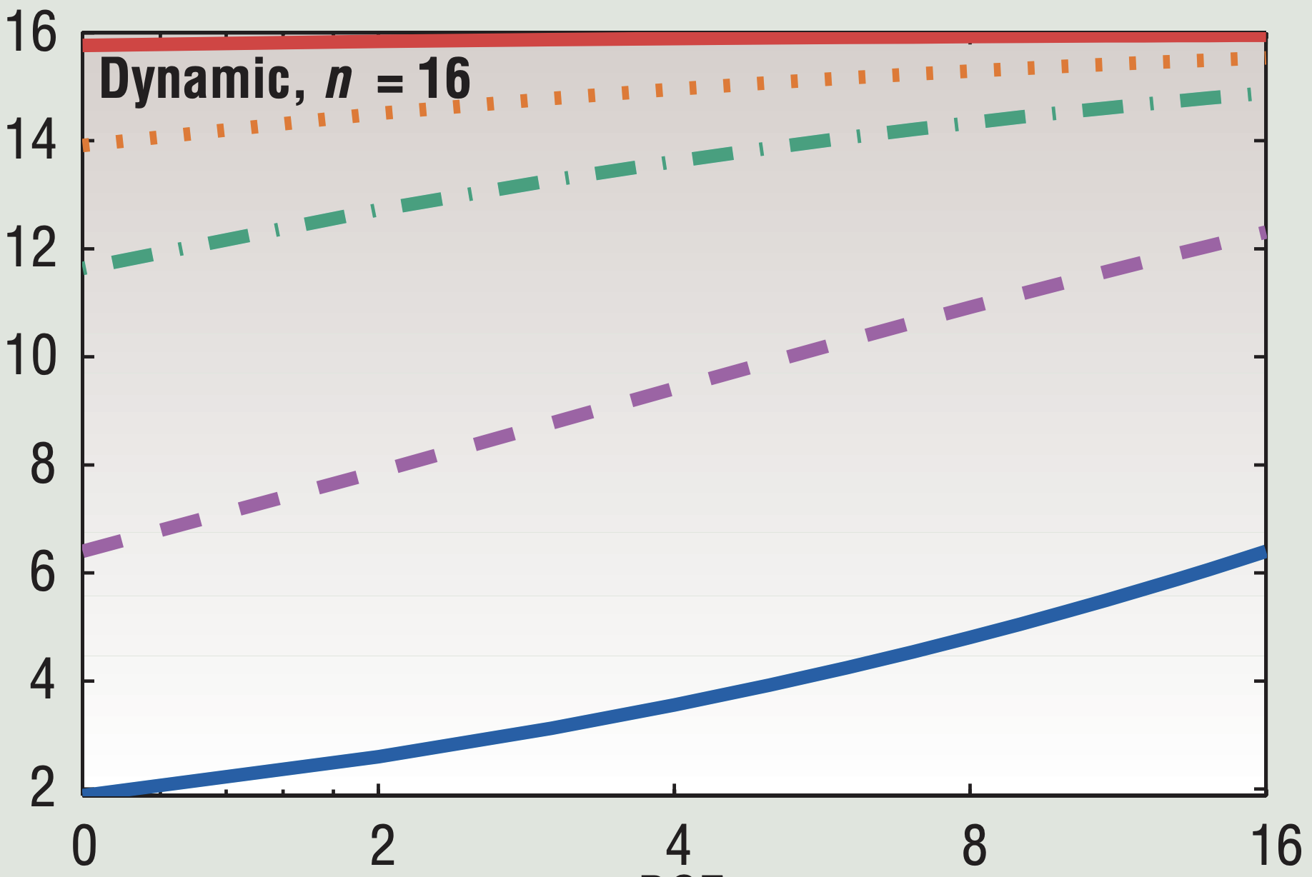
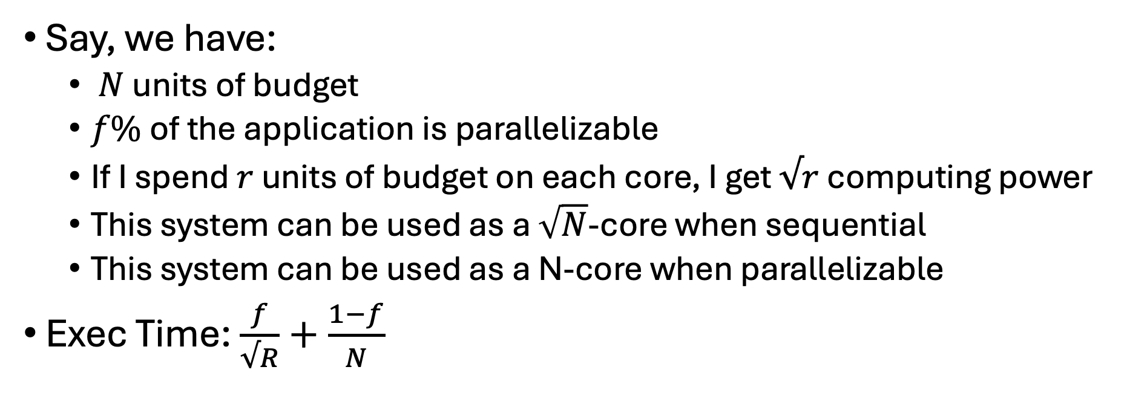
What if we make it even better?
Say, we have:
$N$ units of budget
$f\%$of the application is parallelizable
If I spend $r$ units of budget on each core, I get $√r$ computing power
This system can be used as a $\sqrt{N}$-core when sequential
This system can be used as a N-core when parallelizable
Exec Time: $\frac{f}{√R}+\frac{1−f}{N}$
N small cores, each computing power is 1
Sequential exec time
Speedup over a core w/ 1-unit of budget

Slide 27
Put them together! (CONT’D)
Magic?
No, more engineering and research effort ☹

Slide 28
Summary
Heterogeneity brings more potential on the performance under a same budget
However, it also urges us to seek the better mechanisms on both software stack and hardware design to take advantage

Slide 29
Challenges and Opportunities on Post-Moore’s Law Era
Why?
Why should we have better perf?
Why can’t we have expected perf?
Source: https://github.com/karlrupp/microprocessor-trend-data/

Slide 30
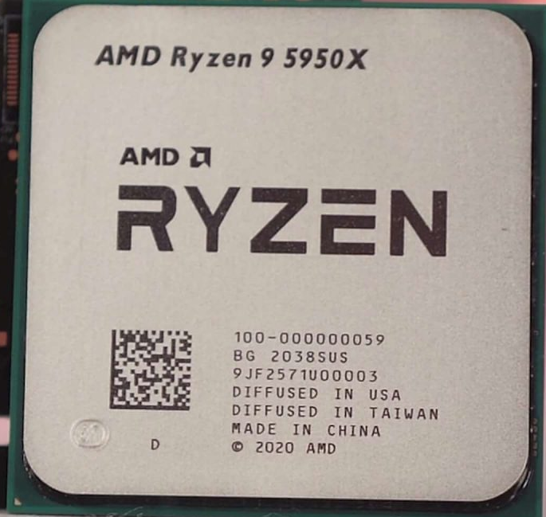






Why should we get more performance?
// Original C Code
for (i=0; i<n; ++i)
c[i] += a[i] * b[i];
Why should we have better perf?
Credits to OpenAI DALL·E
( )
CPU: A Data Factory
Manufacturing: Program
Raw Material: Data
Product: Program Output
Transistors: Budget for the workers and assembly lines
( )
( )
×n
×n
×n
Why can’t we have the expected perf?
What happens in CPU?
What happens to the program?

Slide 31





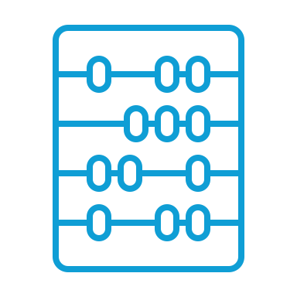




Executing the assembly code? Organizing an assembly line!
IF: “I read the manual for instructions!”
ID: “I check the data availability!”
EX: “I do the computation!”
Credits to OpenAI DALL·E
MA: “I am the warehouse keeper!”
WB: “I check in the results!”
CPU: A Microprocessor
Memory: Warehouse
Registers: Handy place for compute-ready data

Slide 32
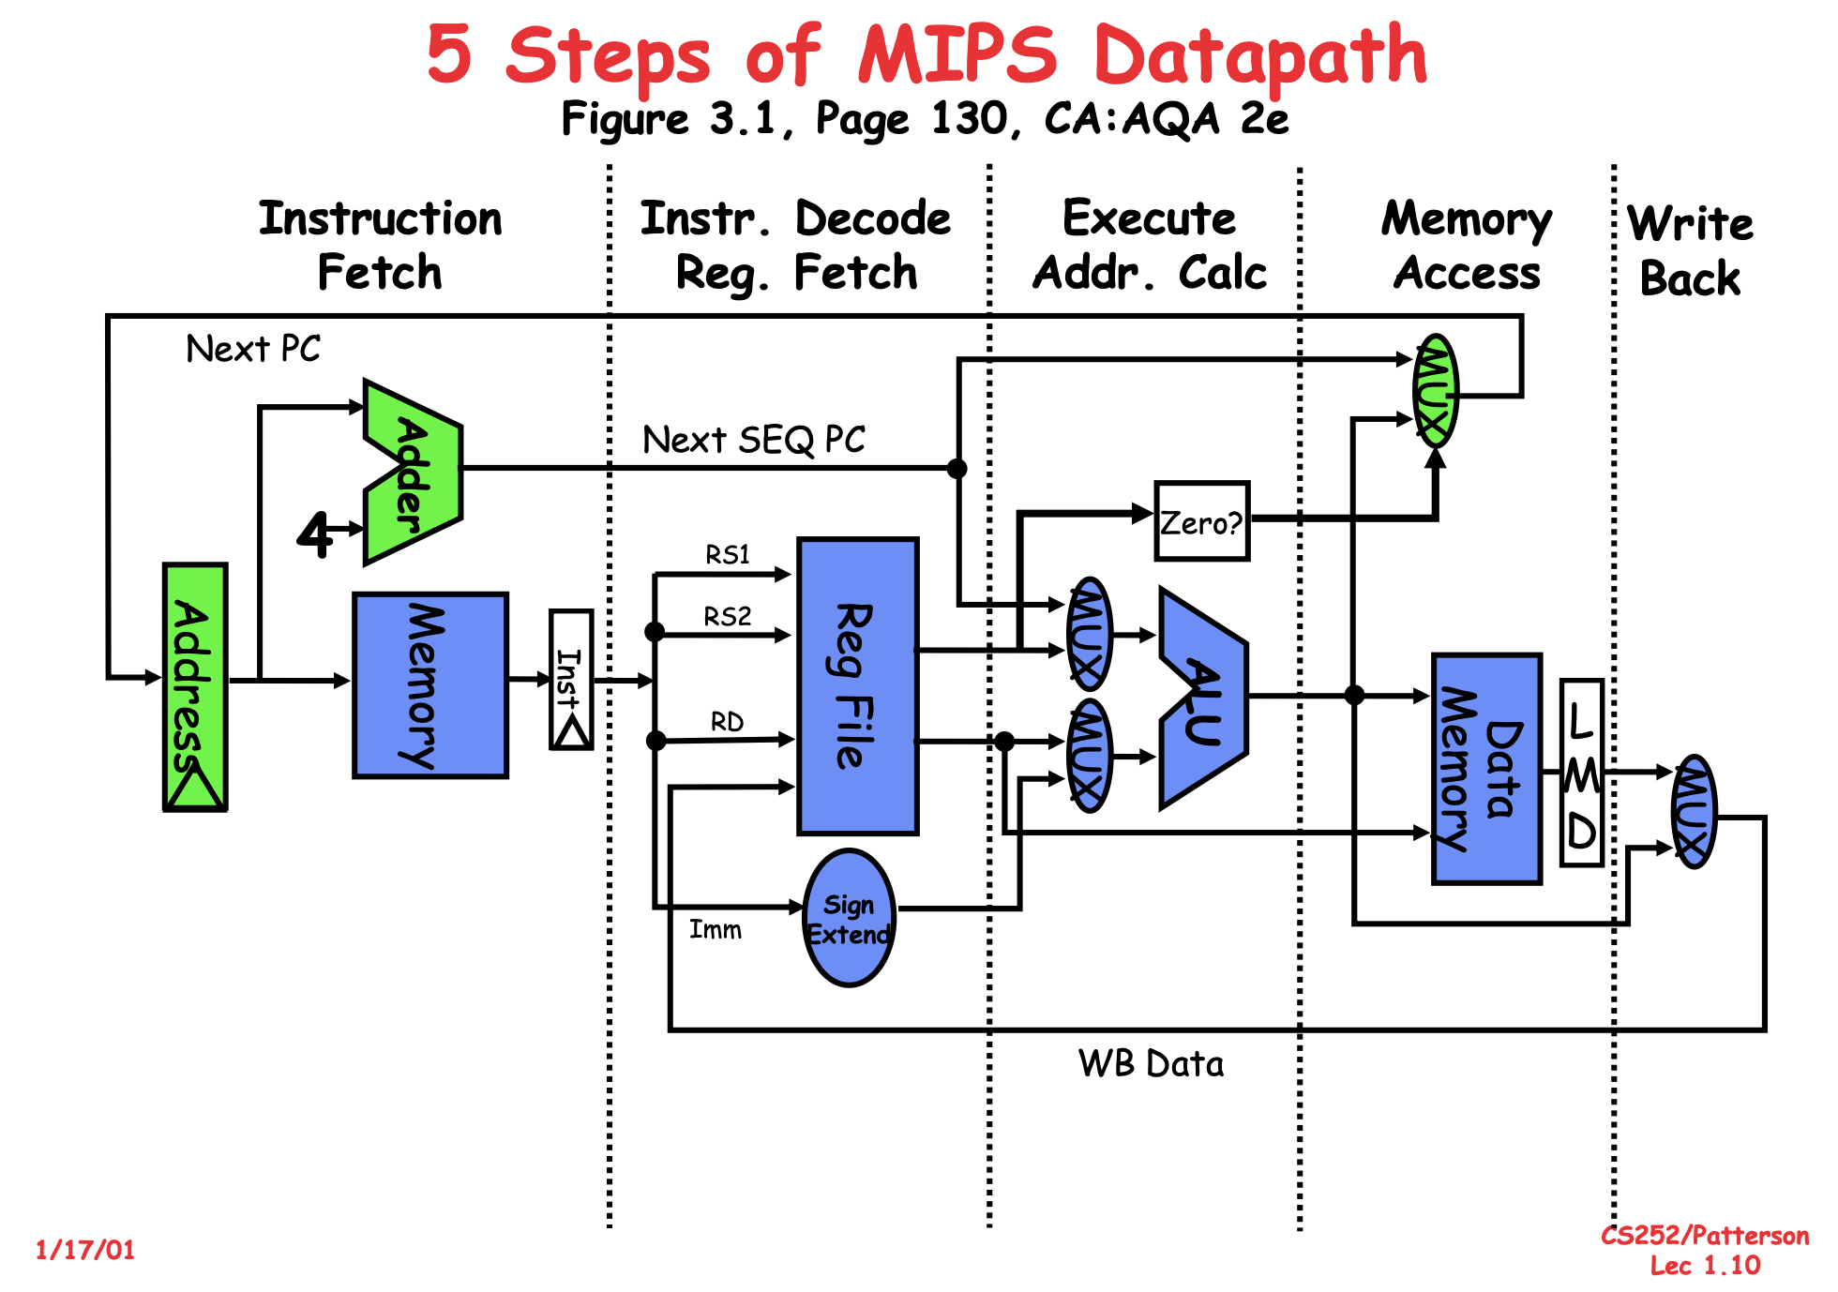
Single-cycled Machine
A long critical path
Simple designs

Slide 33
Recap: Critical Path
Or how good or bad is this solution?
Repeat this block next 31 times
O₀
O₁
O₂
A₀
B₀
A₁
B₁
A₂
B₂
Pros: It works, and it is simple!
Cons: Slow... The longest path is linear to the bit width.
^
^
^
&
Carry
^
^
&
Carry
&
Carry
|
|
…
&
&
|
|
&
&

Slide 34
Recap: The Valve-Liquid Model
High
High
NAND: NOT (A & B)
NAND itself is Turing Complete
A & B
A | B
A ^ B
out
A
B
Stage Registers: Some container for the inter-stage results
Low

Slide 35
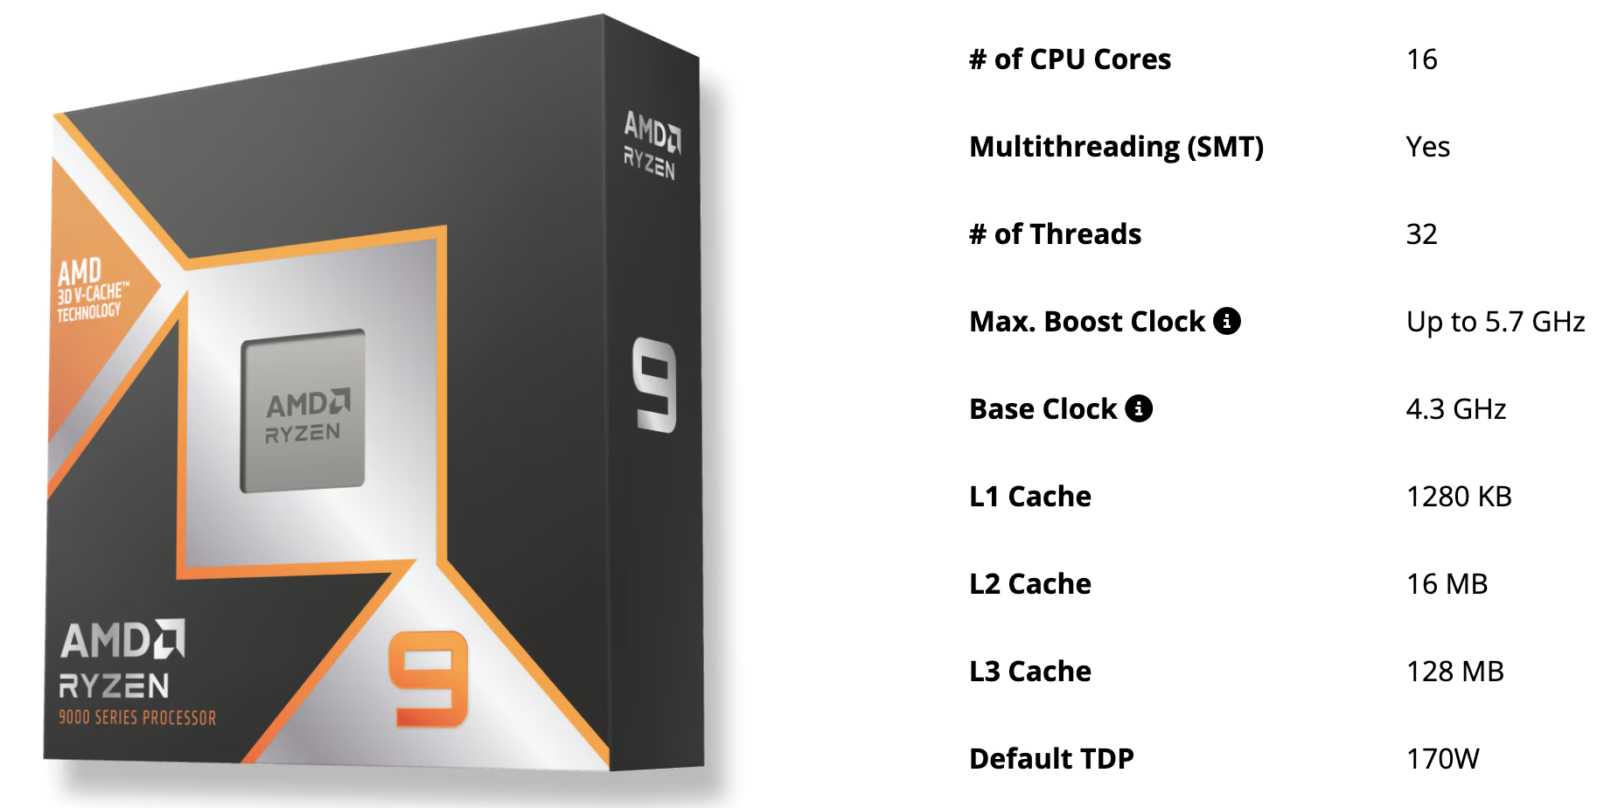
Recap: The CPU Spec.
What is clock freq?
What is cache?
What is core and thread?
Why does TDP matter?
Source: https://www.amd.com/en/products/processors/desktops/ryzen/9000-series/amd-ryzen-9-9950x3d.html

Slide 36
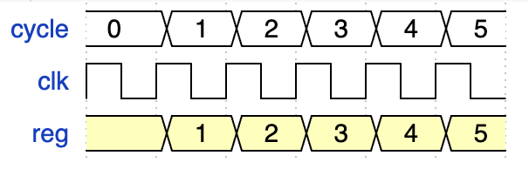
The Waveform (Comb & Seq)
Clock: Periodically generate pos and neg signal
Reg: Can only be written at pos-edge, but the result will take effect in next post-edge.

Slide 37
The Waveform (Comb & Seq)
Clock: Periodically generate pos and neg signal
Reg: Can only be written at pos-edge, but the result will take effect in next post-edge.
Comb is immediately effective
Seq is asynchronized

Slide 38
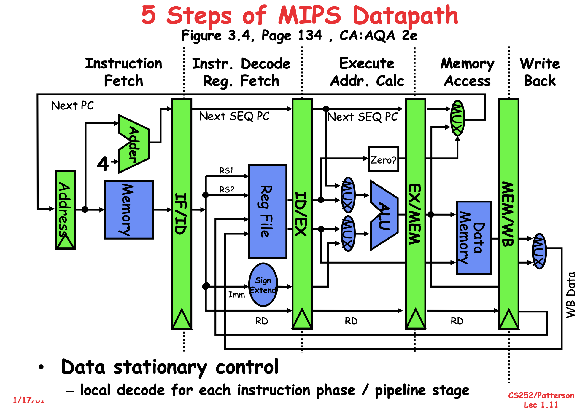
5-stage Pipelined Machine
Stage registers among stages for shorter critical path
More complicated logics for interlocking

Slide 39
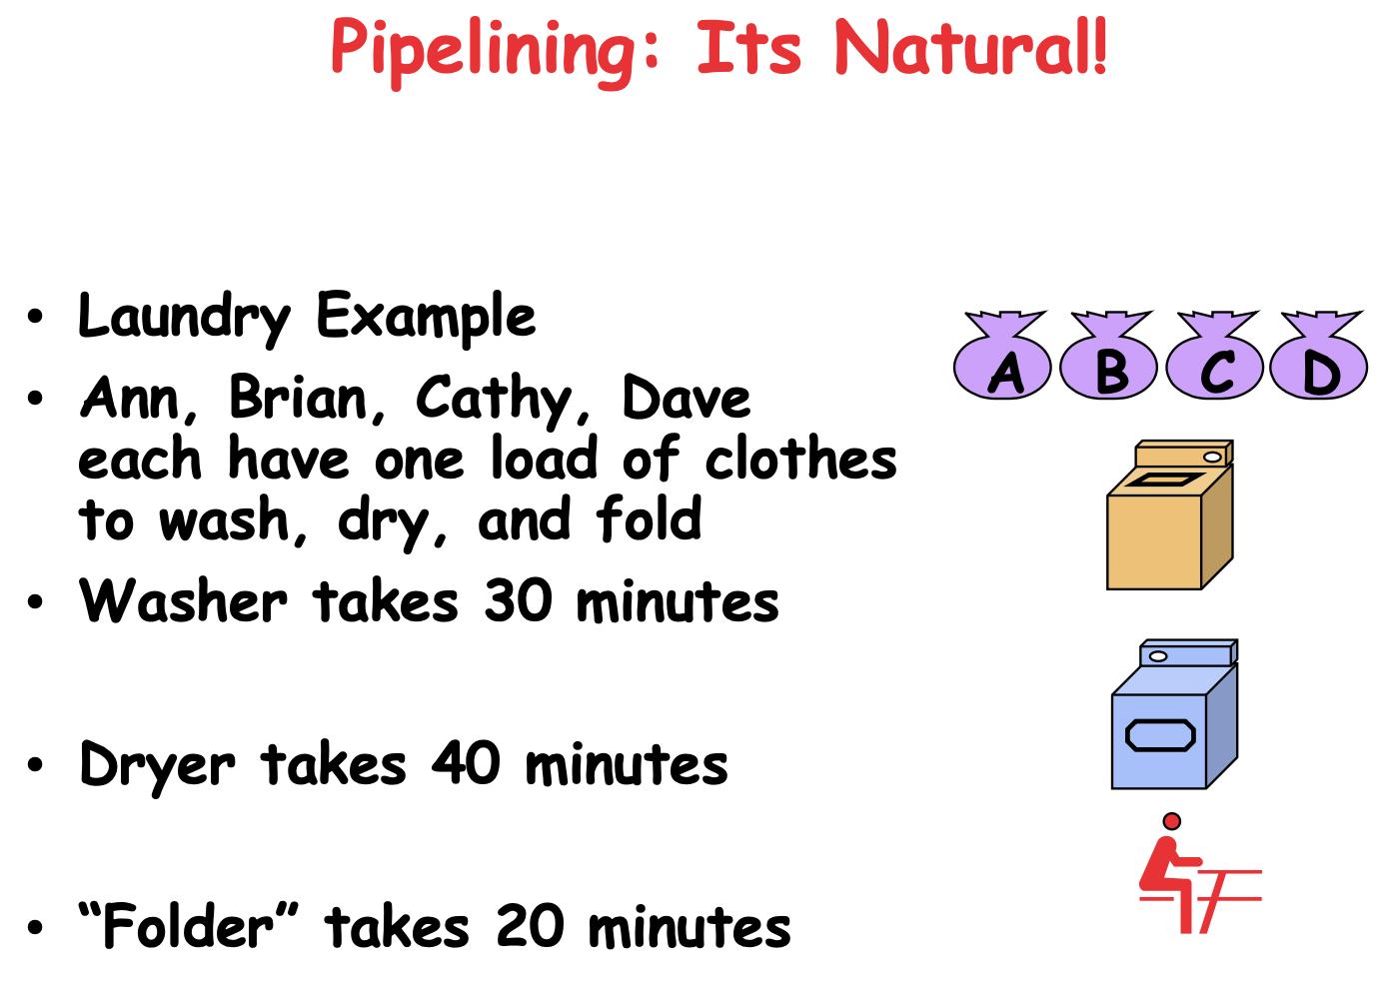

Slide 40
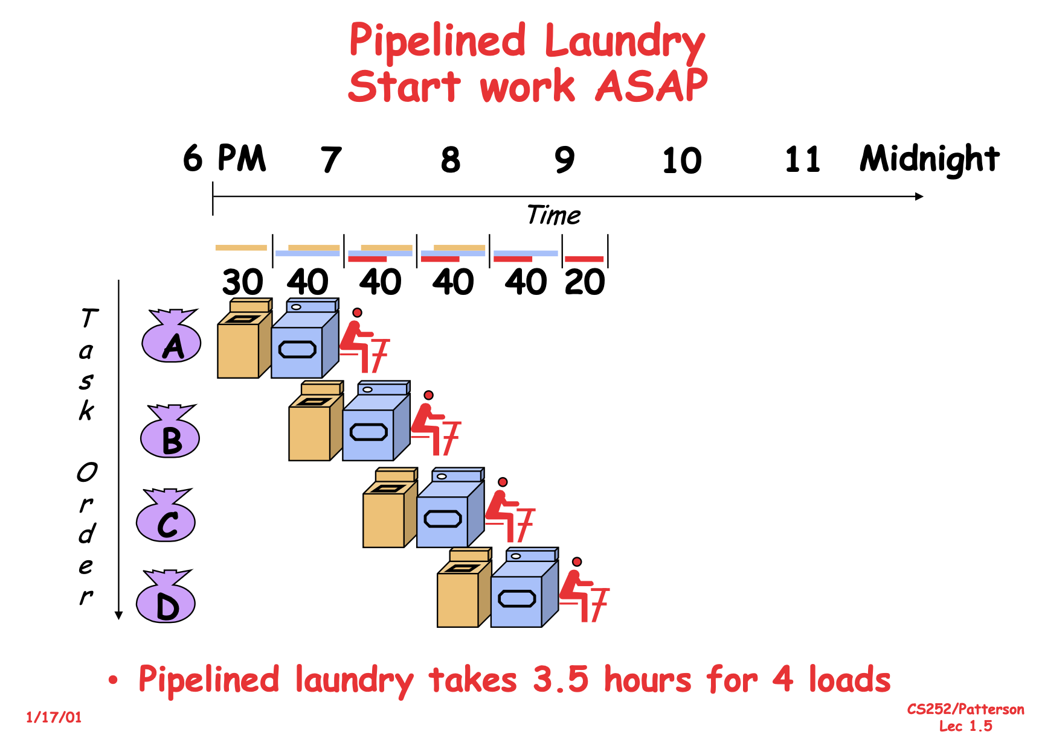

Slide 41
Characterization
Assumption: All the architectures discussed are pipelined.
Instead of saying Tomasulo or other algorithms, I will characterize:
In-/out-of-order
(Non-)Speculative
Single/Multi-issue

Slide 42
Characterization
Assumption: All the architectures discussed are pipelined.
Instead of saying Tomasulo or other algorithms, I will characterize:
In-/out-of-order
(Non-)Speculative
Single/Multi-issue

Slide 43
What are the interlocks for?
Hazards: something the arch has to comply to have the semantics maintained
Types of hazards
Resource hazard
Data hazard
Control hazard

Slide 44
Data Hazard
Enforcing data dependences within a centralized register file
{Read, Write} x {Read, Write}
Why not 4 hazards?
Assuming, we already know the trivial solution
Wait until it works.

Slide 45
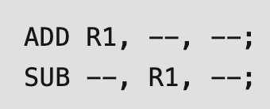
Data Hazard – RAW
Read after write
This is the only “real hazard”

Slide 46
RAW – Bypassing
Decode
Before ADD data is committed to register file
MA
WB
Why?
ADD has nothing to do with memory right?
B is symmetric to A, but to avoid over complicated Fig, it is omitted
Sel
A
B
EX
ADD
MA
WB

Slide 47
Diverged: A Uniform Interfacing
Decode
Why cannot we bypass WB?
Both ADD and LOAD are writing to register!
B is symmetric to A, but to avoid over complicated Fig, it is omitted
Sel
LOAD --, --, --
ADD --, --, --
A
B
EX
ADD
MA
WB

Slide 48
RAW – Fully Bypassing
Decode
Before ADD data is committed to register file
Remember to bypass from MA even it is an ADD!
Even from WB!
B is symmetric to A, but to avoid over complicated Fig, it is omitted
Sel
A
B
EX
ADD
MA
WB

Slide 49
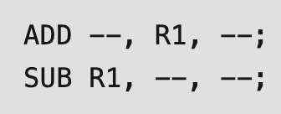
Data Hazard – WAR
Write after read
DIV --, R1, --
SUB R1, --, --

Slide 50
WAR – A Zoom in
A maybe good enough demo
Subtract
Register File
DIV --, R1, --
SUB R1, --, --
Read R1
MA
…
Division Pipeline
WB

Slide 51
WAR – Operand Buffer
Duplicate R1/R2 here
A maybe good enough demo
Register File
DIV --, R1, --
SUB R1, --, --
Read R1
MA
…
Division Pipeline
WB

Slide 52
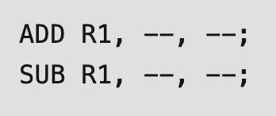
Data Hazard - WAW
Is it a fake hazard?
DIV R1, --, --
SUB R1, --, --

Slide 53
WAW – Register Renaming
Allocate a mapping entry each time
This is a full delegate to the register
Further read and write will be redirected to this mapped register
rename_entry = alloc_entry()
rename[rd] = rename_entry
r1_data = data[rename[rs1]]
++use[rename[rs1]]
r2_data = data[rename[rs2]]
++use[rename[rs2]]
IF
ID
EX
MA
data[rename_entry] = result
if use[rename_entry] == 0 {
dealloc(rename_entry) }
WB

Slide 54
WAW – Register Renaming
Program
Algorithm
Data structure
Architecture
Pipeline logic
Bookkeeping
rename_entry = alloc_entry()
rename[rd] = rename_entry
r1_data = data[rename[rs1]]
++use[rename[rs1]]
r2_data = data[rename[rs2]]
++use[rename[rs2]]
IF
ID
EX
MA
data[rename_entry] = result
if use[rename_entry] == 0 {
dealloc(rename_entry) }
WB

